Slide 1

TEAM: 12 SMART AUTOMATION AND MOBILITY(SAM) 6TH SEMESTER
1

Slide 2
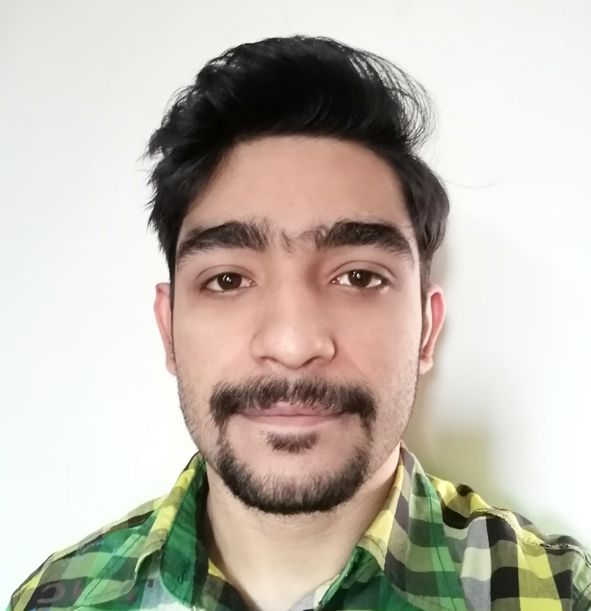
Hello!
I am Aditya Vikram Sharma
ID-191001111023
BSc. IT Machine Learning
Semester-6th
Batch-2019-2022

Slide 3
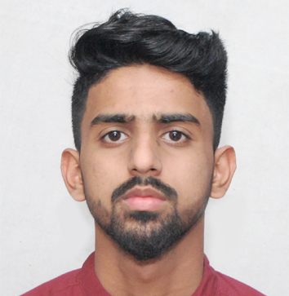
Hi!
I am Gopal Pacheriya
ID-191001111010
BSc. IT Machine Learning
Semester-6th
Batch-2019-2022

Slide 4
What is SAM?
SAM is a new and revolutionary way of thinking about how we get around — one that is cleaner, safer, and more efficient.
This can take on many different forms, including ride-sharing, car-sharing, public transportation, walking, biking, and more.

Slide 5
Why we need SAM?
It is a must for a Smart City
Reduce noise & air pollution
Improve and control traffic flow
Control energy resources for mobility
Space management
5

Slide 6
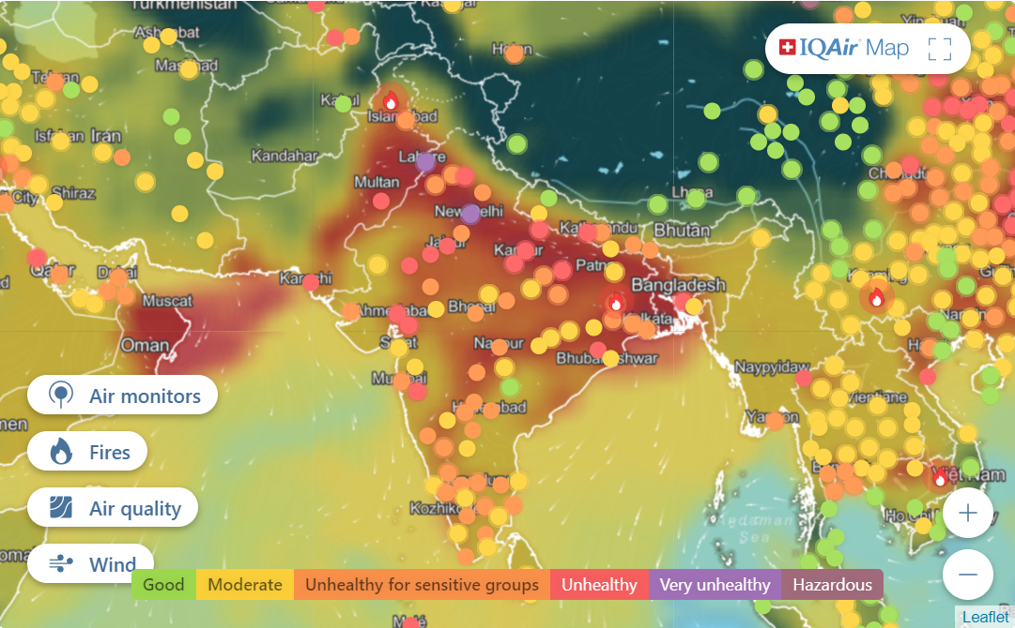
Air Pollution is drastically increasing and we must find a way to stop it!
6

Slide 7
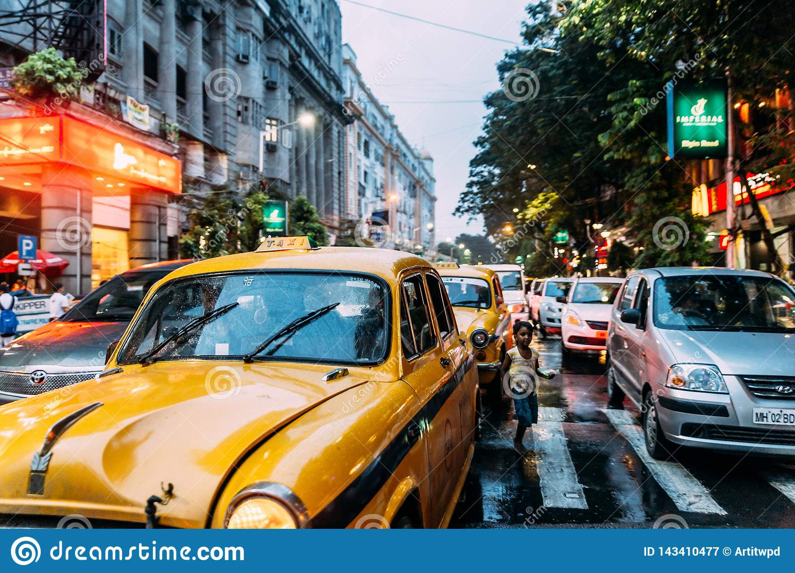
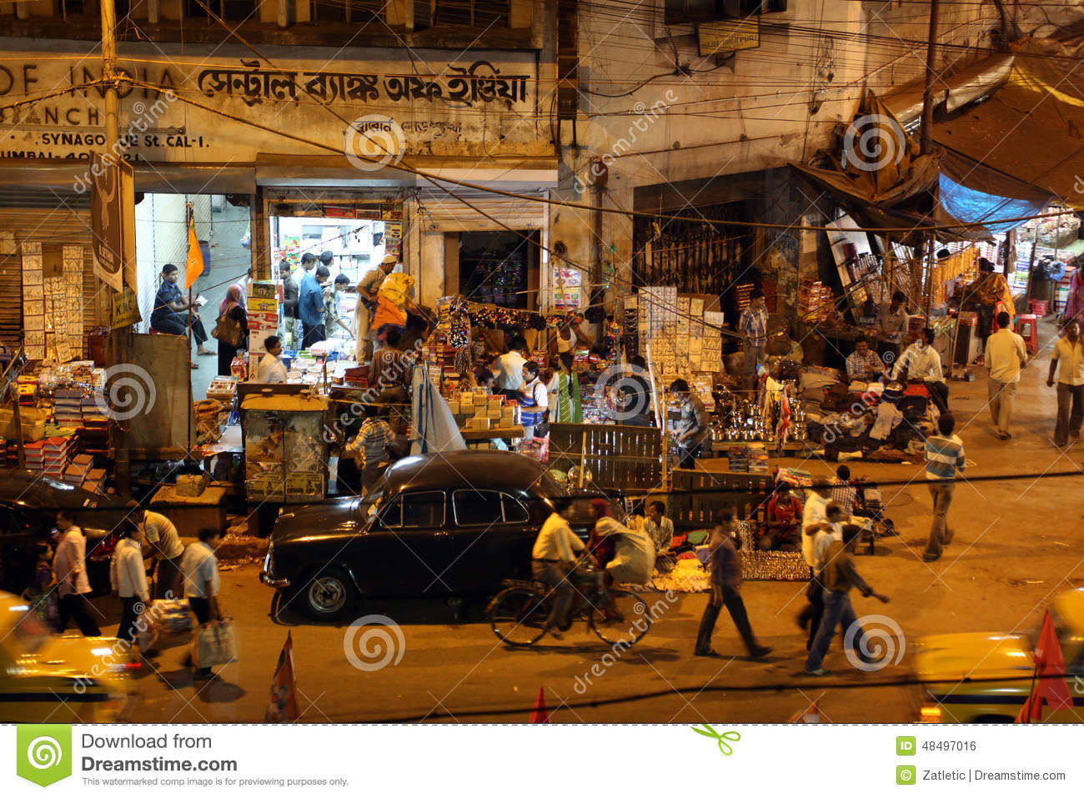
Availability of space
Lack of space is one of the most alarming situations in India
Roads are often jammed with 4 wheelers, buses and trucks
7

Slide 8
Our Mission
Our mission is to create a platform which will provide a variety of efficient and green transportation services to all our users.

Slide 9
Our Vision:
SAM(Smart Automation and Mobility)
Our vision is to create a Website/Android/IOS application which will provide various transportation services like ridesharing, booking electric buses, metros, cars, 2-wheelers, including a vehicle renting option and much more.
Our platform will be a single place for managing all the related payments. It will completely change the future of transportation.

Slide 10
PROS OF SAM
One convenient app for various modes of transportation
Only electric vehicles will be used thus it will substantially improve the air quality of the city
One app for all related cashless payments
User friendly interface

Slide 11
CONS OF SAM
Shifting from diesel and petrol to electric vehicles will take time.
People are still not completely familiar with cashless payments.
Online platform possess the risk of cyber attacks.

Slide 12
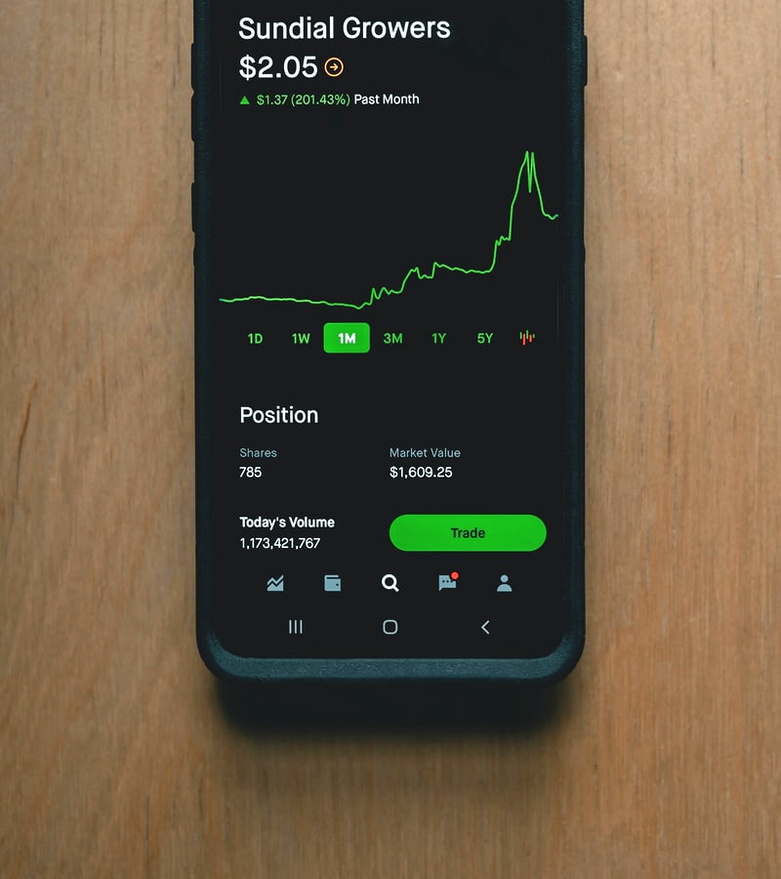
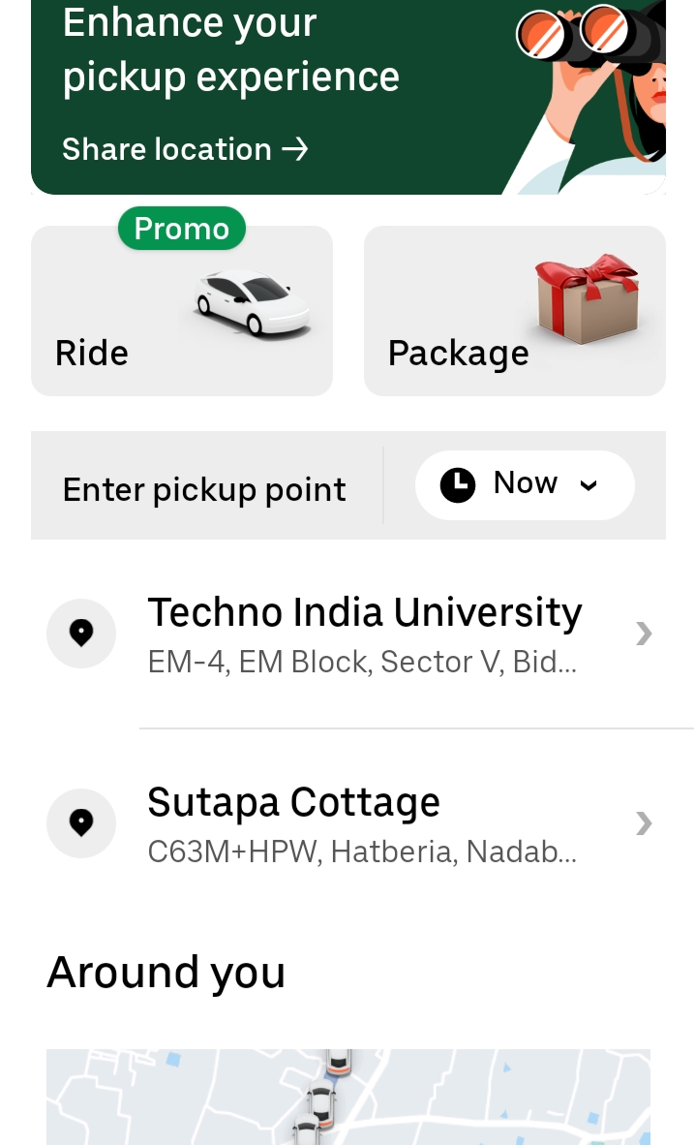
COMPETITORS BIG GIANTS LIKE UBER, OLA
These apps only provide a limited number of transportation services and the use of diesel and petrol vehicles puts a serious toll on the city’s air quality.

Slide 13
BASIC OVERVIEW OF SAM
SAM
USERS
DRIVERS
GETTING SERVICES
MAKING PAYMENTS
PROVIDING SERVICE
GETTING PAYMENTS

Slide 14
HOW SAM IS BUILT?
HTML
THE BASIC STRUCTURE
CSS
FOR BEAUTIFICATION AND STYLING
JAVASCRIPT
TO CARRY OUT THE VARIOUS FUNCTIONS
NODE.JS
BACKEND OF WEBSITE
MONGODB
TO STORE ALL THE DATA
APACHE2
FOR HOSTING THE WEBSITE

Slide 15
COST OF BUILDING SAM
There is no initial cost of building SAM as it is completely made by us from scratch. It is still in its prototype form and requires further testing and upgradation.

Slide 16
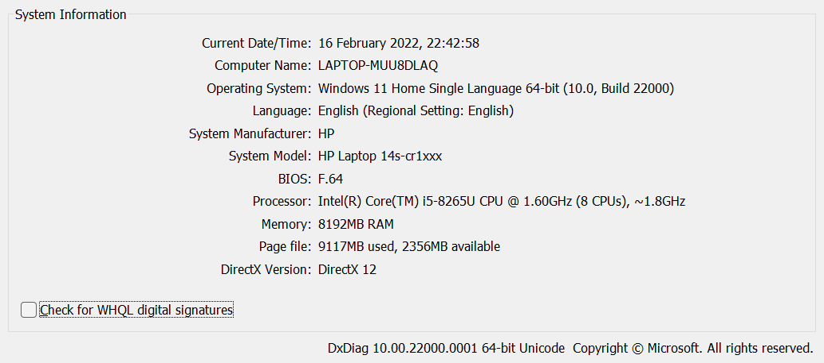
SYSTEM SPECIFICATION

Slide 17
SWOT ANALYSIS
STRENGTHS
ONE APP FOR ALL TRANSPORTATION SERVICES AND ONE APP FOR ALL RELATED PAYMENTS
WEAKNESSES
SHIFTING FROM DIESEL AND PETROL TO ELECTRIC VEHICLES WILL TAKE TIME
S
W
A MUCH MORE EFFICIENT AND GREENER MODE OF TRANSPORTATION
OPPORTUNITIES
CYBER THREATS AS THE PLATFORM IS ONLINE BASED
THREATS
O
T

Slide 18
ROADMAP FOR 2YEARS
BUILDING THE PLATFORM FROM SCRATCH
BUILDING AN E-WALLET FOR ALL CASHLESS PAYMENTS
UPGRADING THE
APP WITH NEWER FEATURES
1
3
5
2
4
6
ADDING FEATURES SUCH AS BOOKING AND RENTING EVS
TESTING
THE PROTOTYPE FOR FLAWS
MAKING THE APP SECURE FROM CYBER ATTACKS

Slide 19
TIMELINE OF DEVELOPMENT
MAKING THE BASIC STRUCTURE USING HTML5
ADDING JAVASCRIPT FOR VARIOUS FUNCTIONS
MONGODB DATABASE FOR STORING ALL THE DATA
TESTING OUR PROTOTYPE WEBSITE
ENHANCHING THE SECURITY OF THE APP
JAN
FEB
MAR
APR
MAY
JUN
JUL
AUG
SEP
OCT
NOV
DEC
ADDING CSS FOR STYLING
FINISHING THE BACKEND USING NODEJS
HOSTING OUR WEBSITE USING APACHE2
REMOVING FLAWS AND ADDING NEW FEATURES
UPDATING THE APP DEPENDING ON USER FEEDBACK

Slide 20
ACKNOWLEDGEMENT
We would like to express a special thanks of gratitude towards our mentor “Ms Rituparna Mondal” for her guidance and support in completing our project.
We would also like to extend our gratitude towards our respectable H.O.D “Dr. Gagan Pareek” for providing us with all the necessary resources and giving us the opportunity to work on a project that has given us so much exposure and knowledge about the business world.

Slide 21
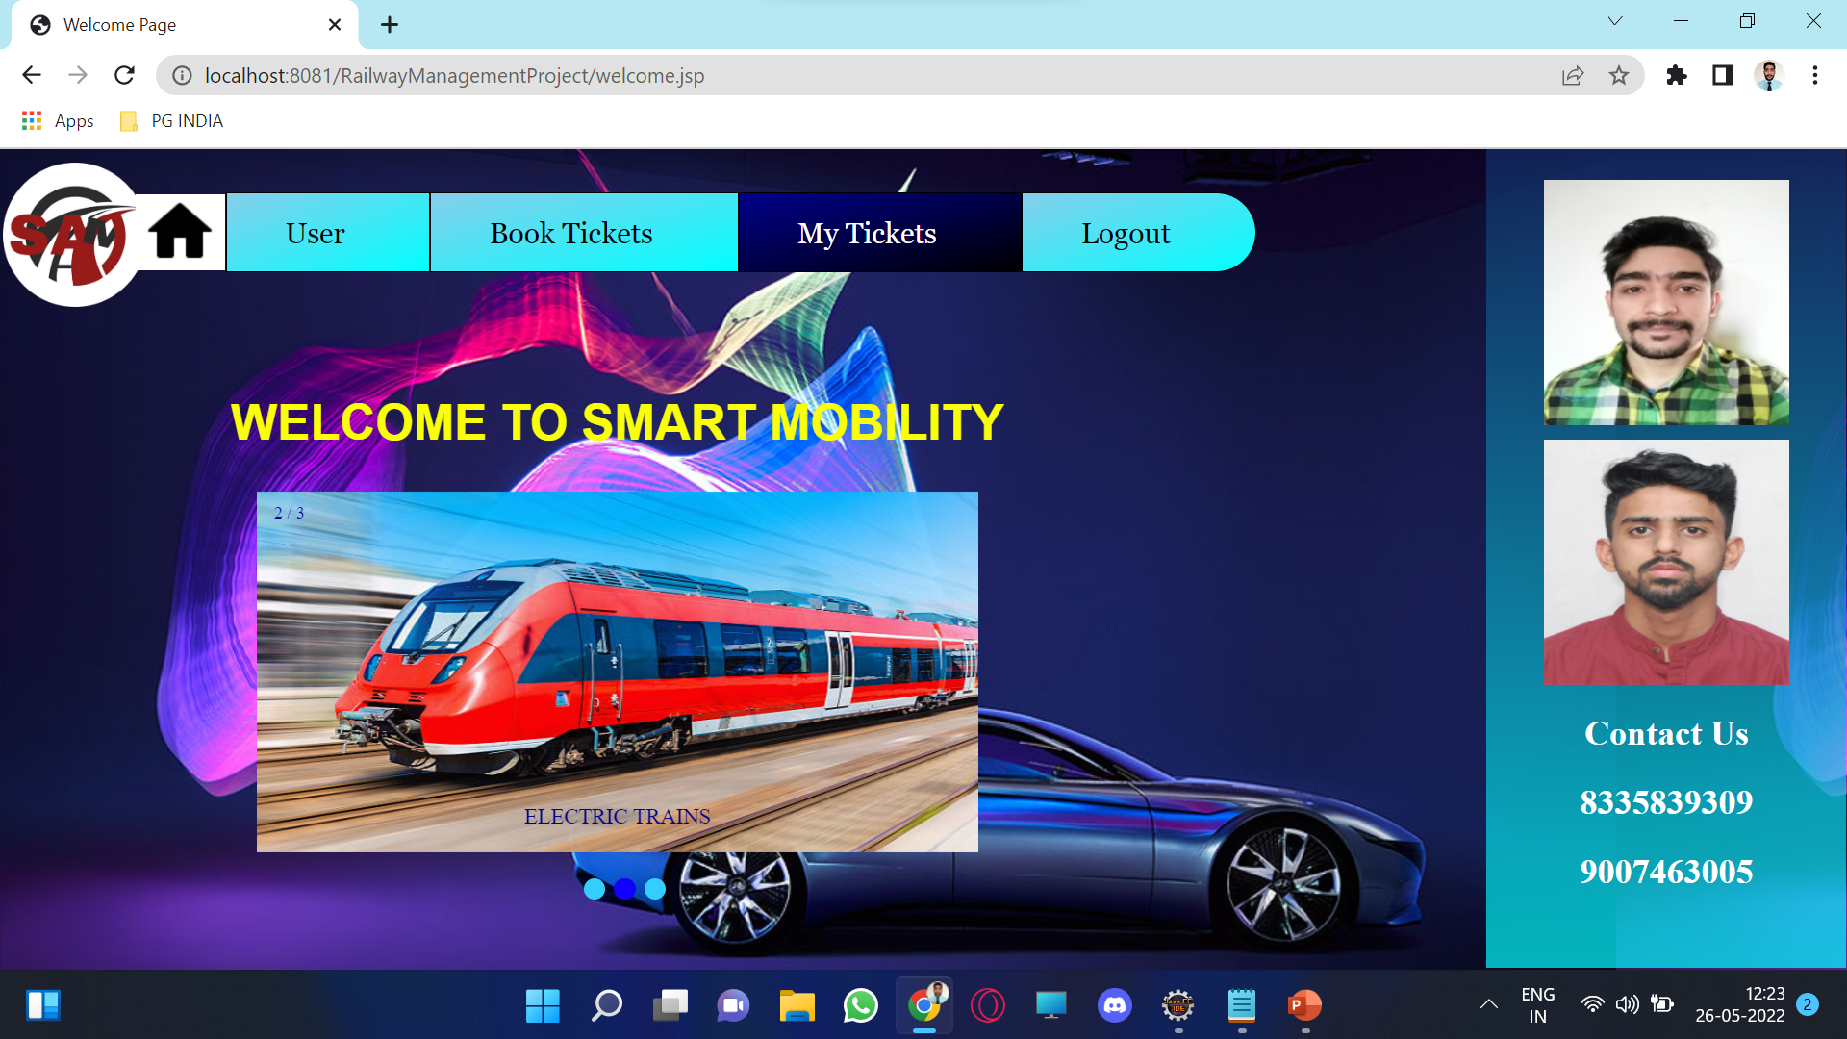
Desktop Project

Slide 22
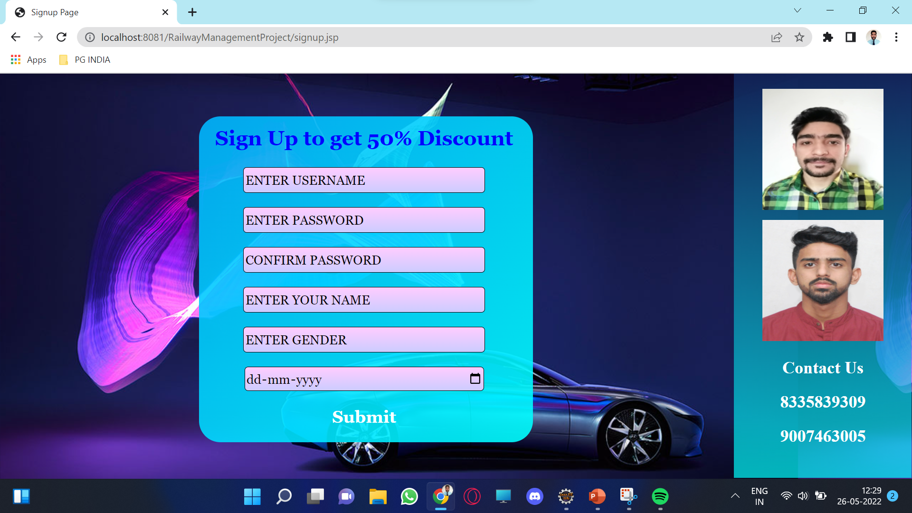
Desktop Project

Slide 23
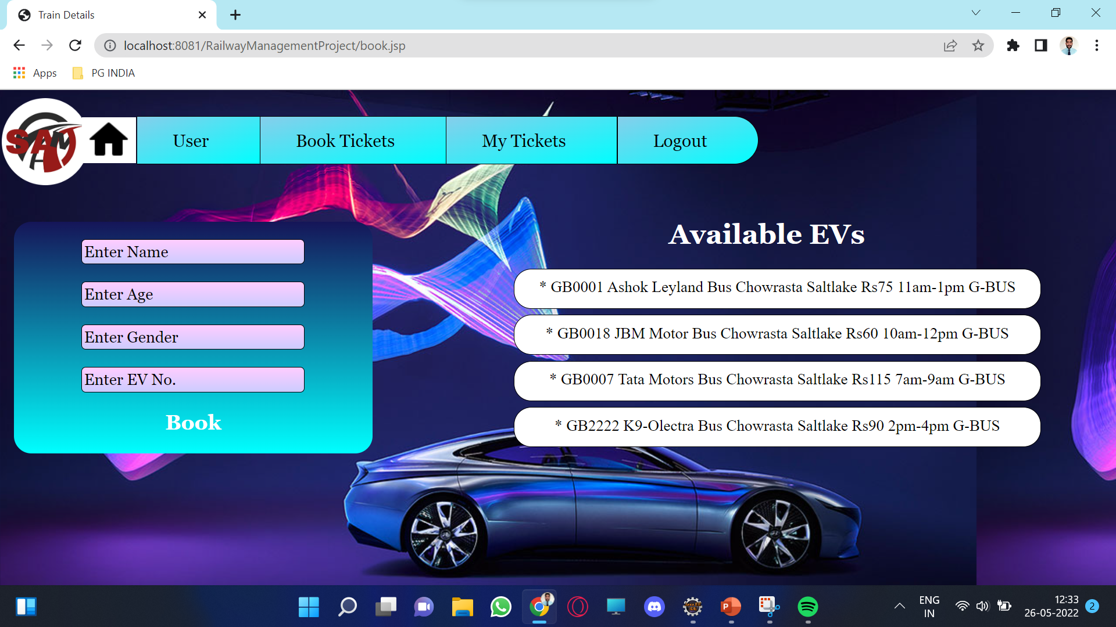
Desktop Project

Slide 24
Thanks!
Any questions? You can find us at:
adityavsharma1023@gmail.com
gopalpacheriya144@gmail.com

